Slide 1
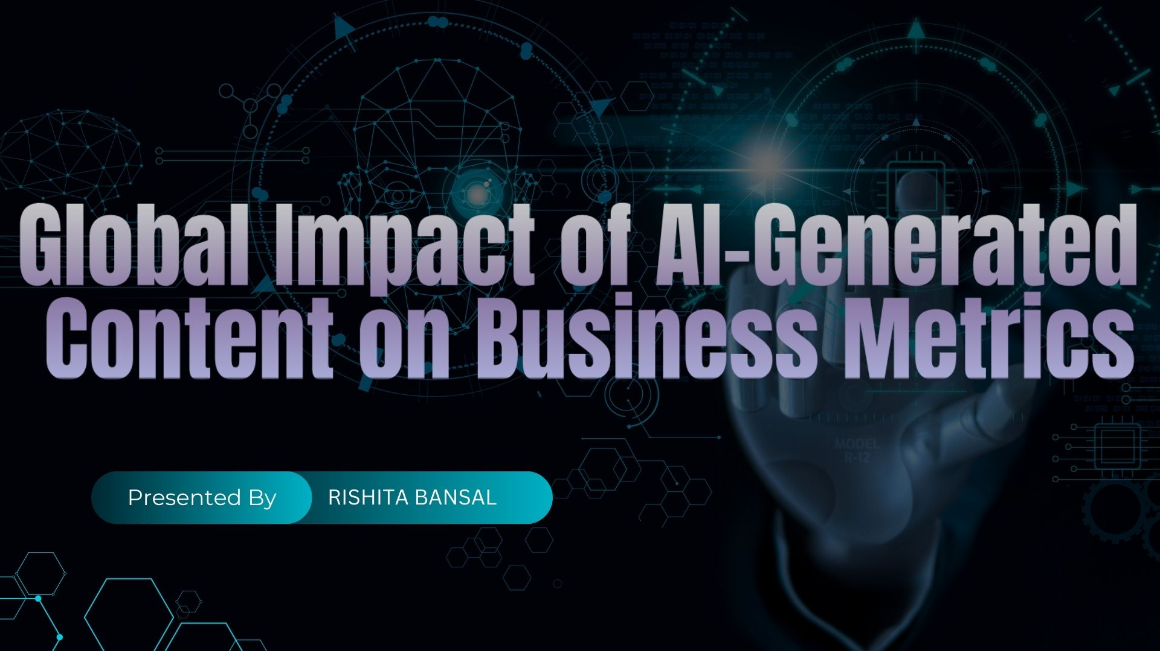

Slide 2


AGENDA
INTRODUCTION
DATA OVERVIEW
BUSINESS PROBLEMS
DASHBOARD
INSIGHTS
CONCLUSION
RECOMMENDATIONS & FUTURE OUTLOOK
Q&A

Slide 3
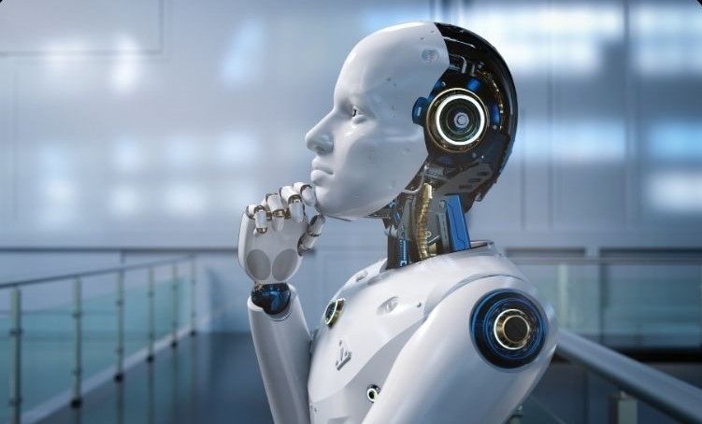
INTRODUCTION
WELCOME TO FUTURE
This project explores the Global Impact of AI-Generated Content using insights derived from the Global AI Content Impact Dataset. By analyzing trends across regions, industries, and content types, we aim to understand how AI-generated content influences productivity, engagement, and business outcomes. The project combines data analysis with visualization techniques in Python, SQL, and Power BI to address key business questions and support strategic decision-making.

Slide 4
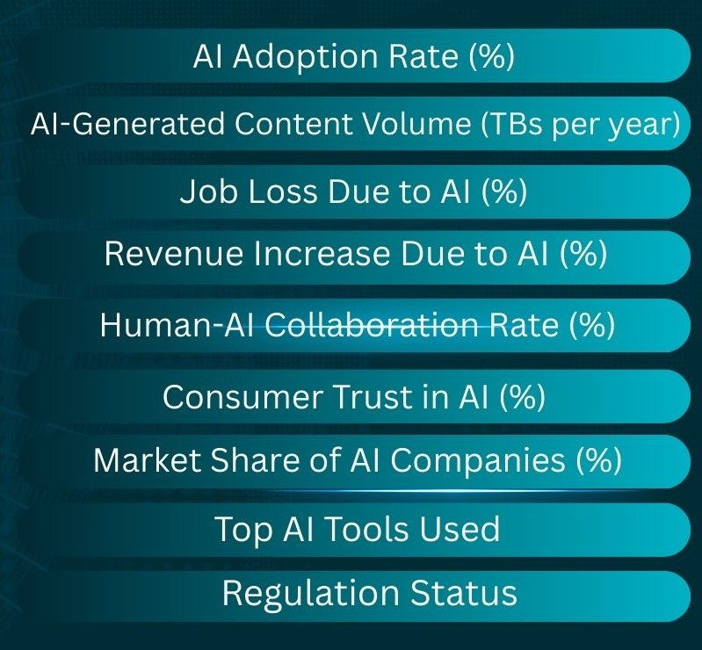
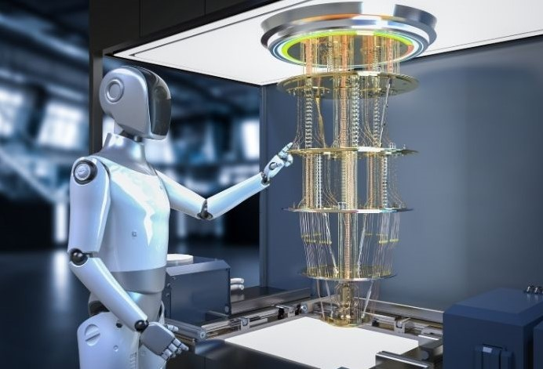
DATA OVERVIEW

Slide 5

🎯 Market Penetration Problem Which countries or industries are adopting AI the fastest?

Slide 6

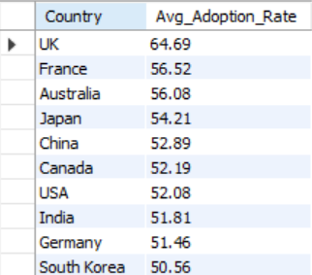
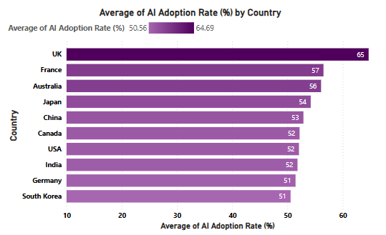
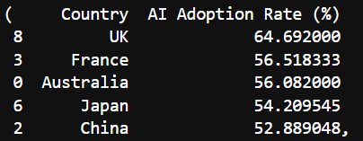
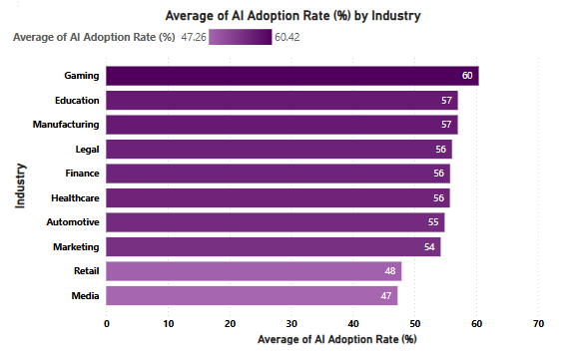
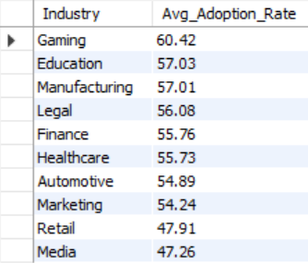
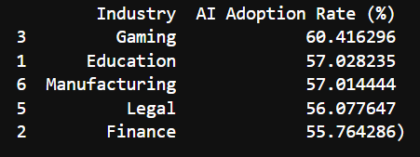
COUNTRY
INDUSTRY

Slide 7
🎯 Revenue Growth Problem Which AI tools or regions see the highest revenue growth due to AI?

Slide 8
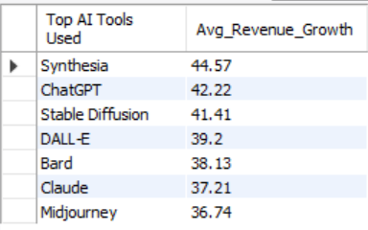
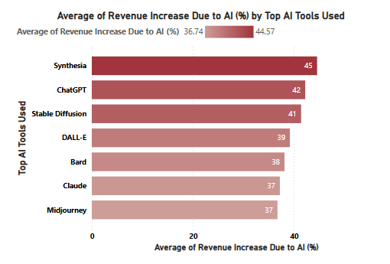
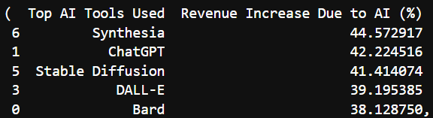
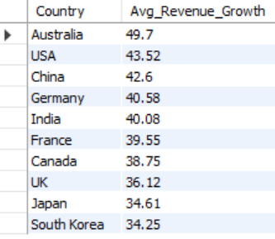
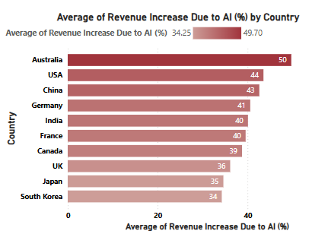
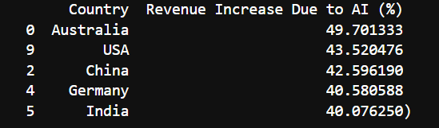
COUNTRY
INDUSTRY

Slide 9
🎯Operational Efficiency Problem How does AI impact human-AI collaboration in various sectors?

Slide 10
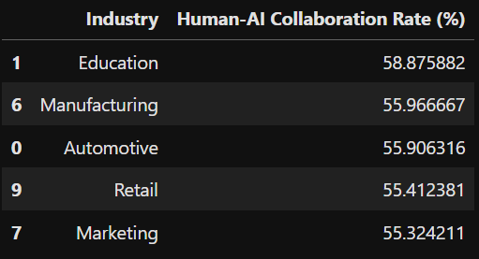
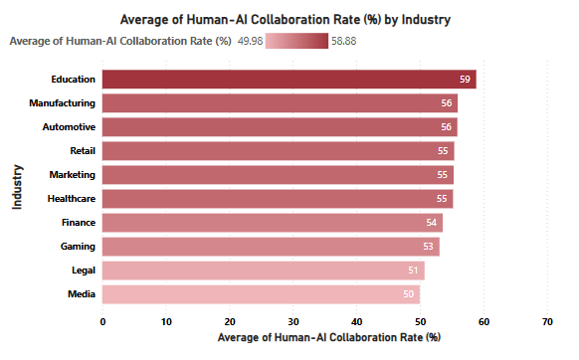
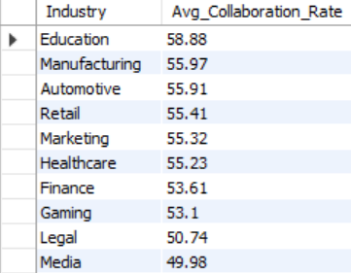
HUMAN-AI COLLABORATION RATE (%)

Slide 11
🎯 Job Loss Risk Assessment What is the projected risk of job loss due to AI in each country/industry?

Slide 12
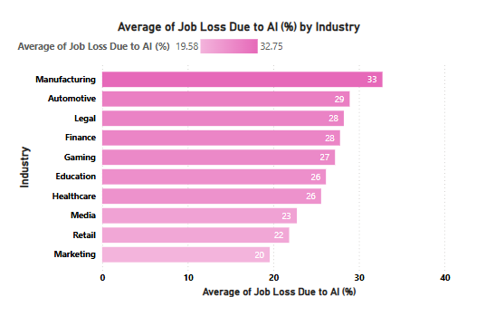
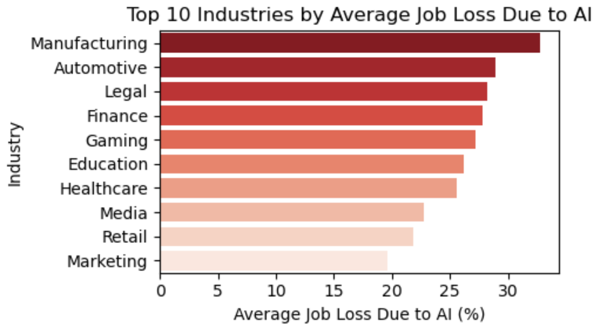
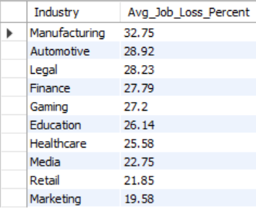
INDUSTRY

Slide 13
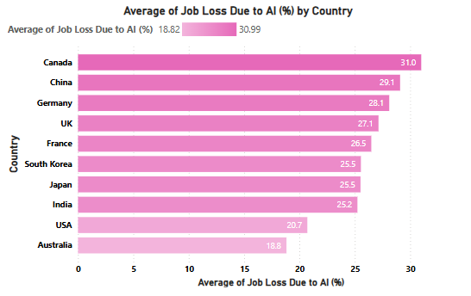
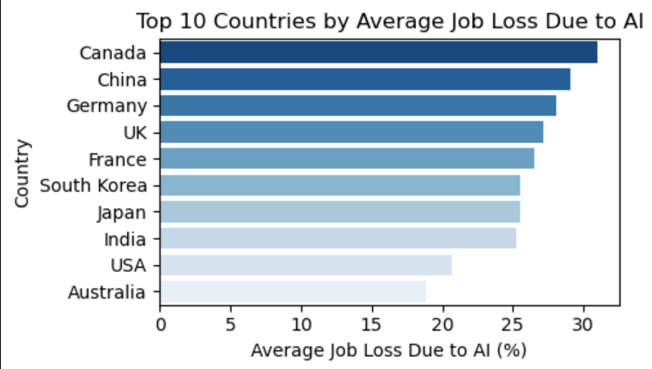
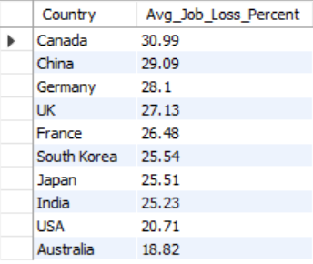
COUNTRY

Slide 14
🎯 AI Impact on Revenue Which industries or countries are seeing the highest revenue increases due to AI adoption?

Slide 15
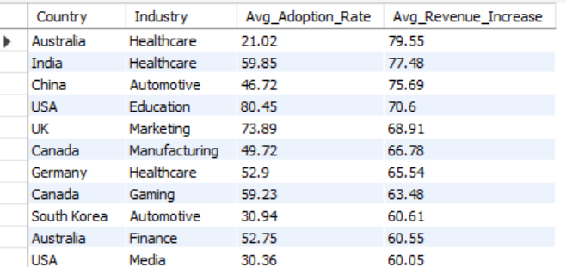
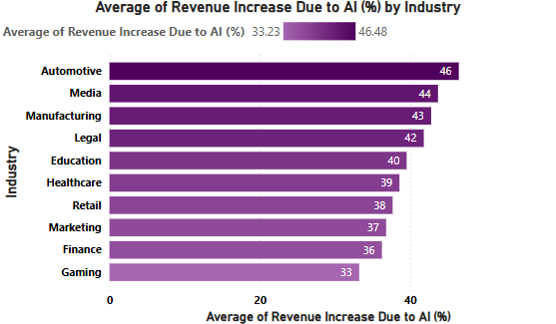
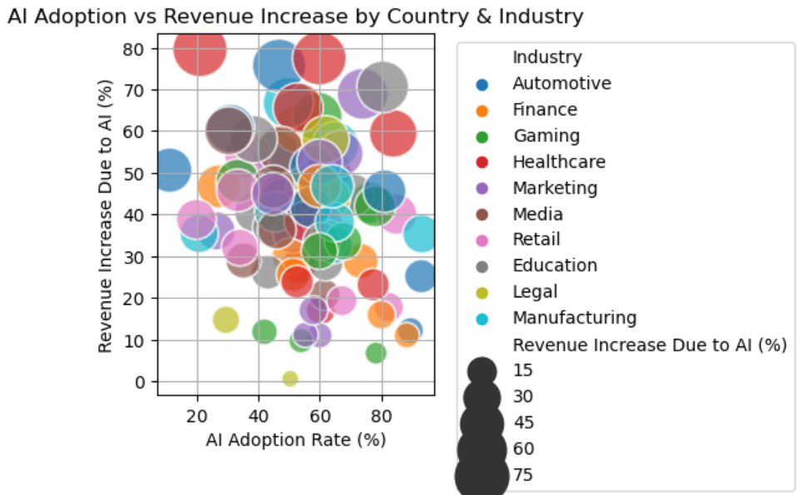
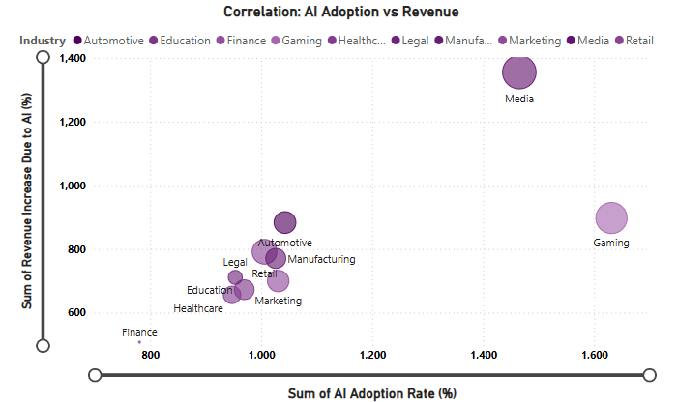

Slide 16
🎯AI Tool Effectiveness Analysis Which AI tools are associated with higher collaboration rates, content output, or revenue growth?

Slide 17
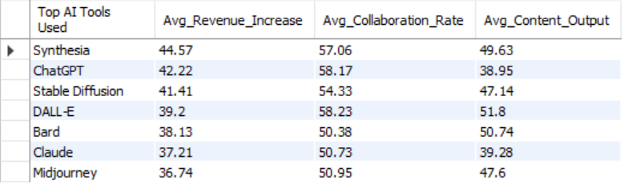
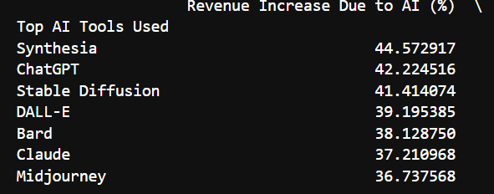
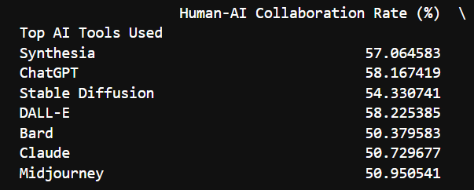
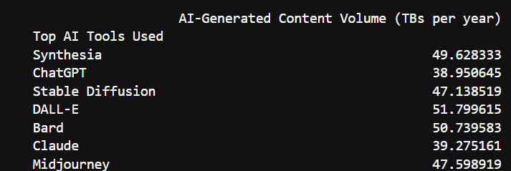

Slide 18
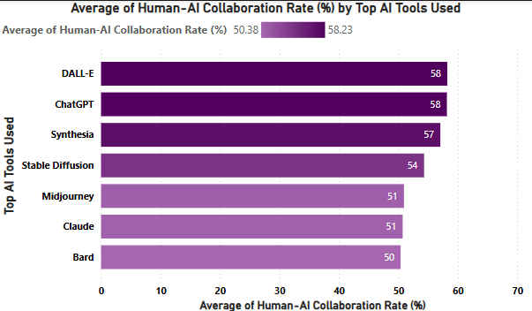
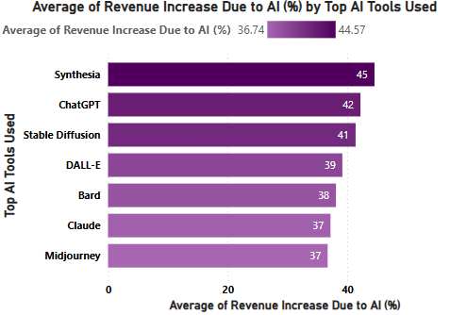
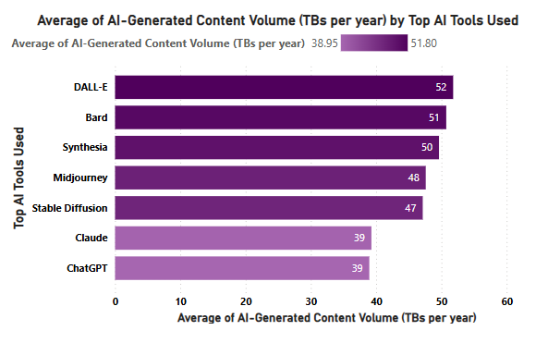

Slide 19
🎯Regulation vs Innovation Does stricter AI regulation affect adoption rates, revenue growth, or consumer trust?

Slide 20
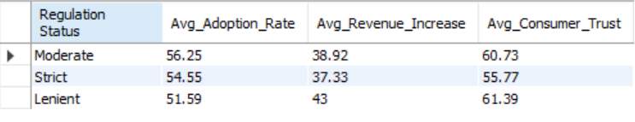
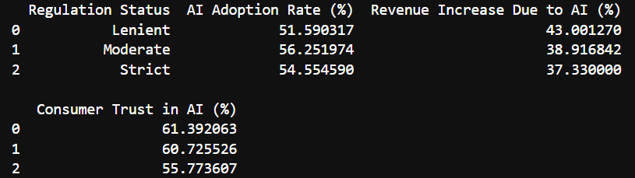
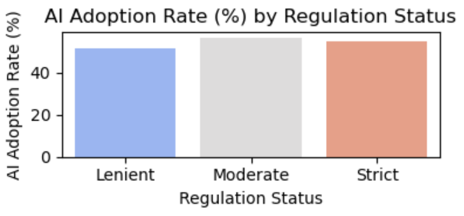
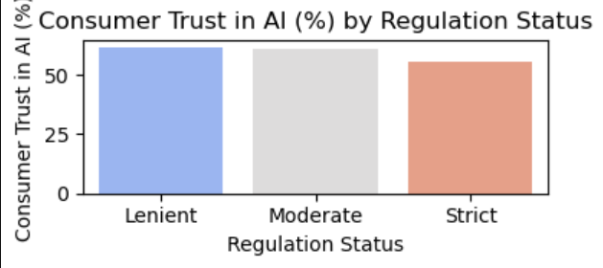
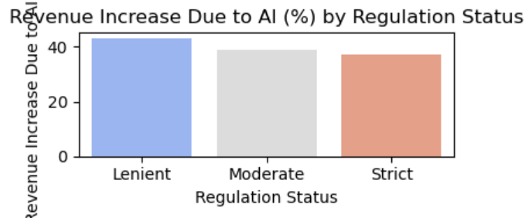

Slide 21
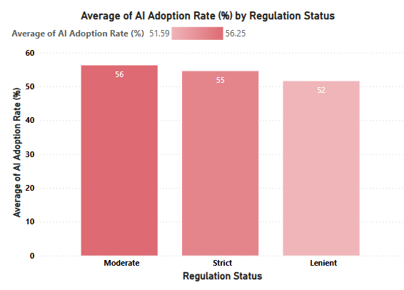
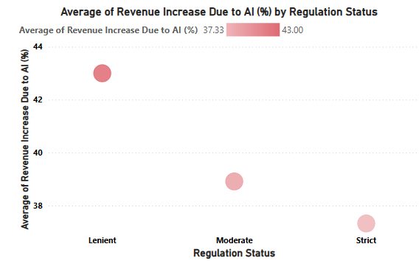
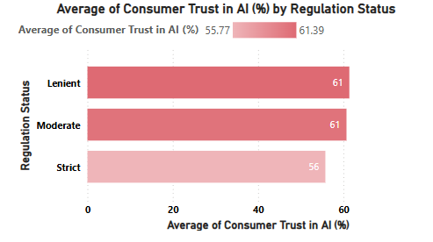

Slide 22
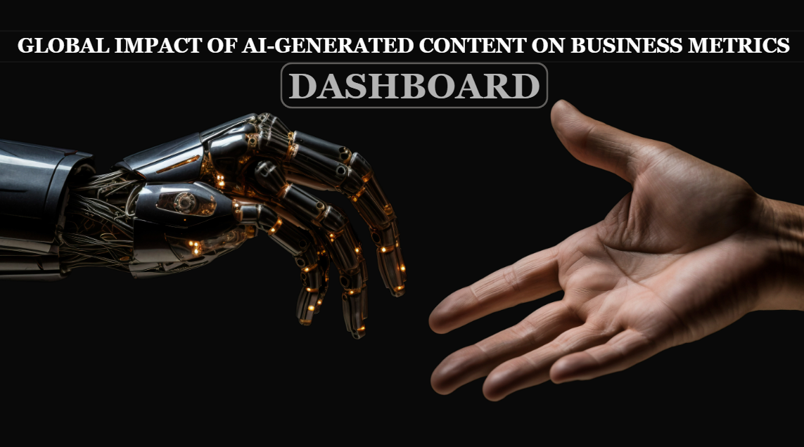

Slide 23
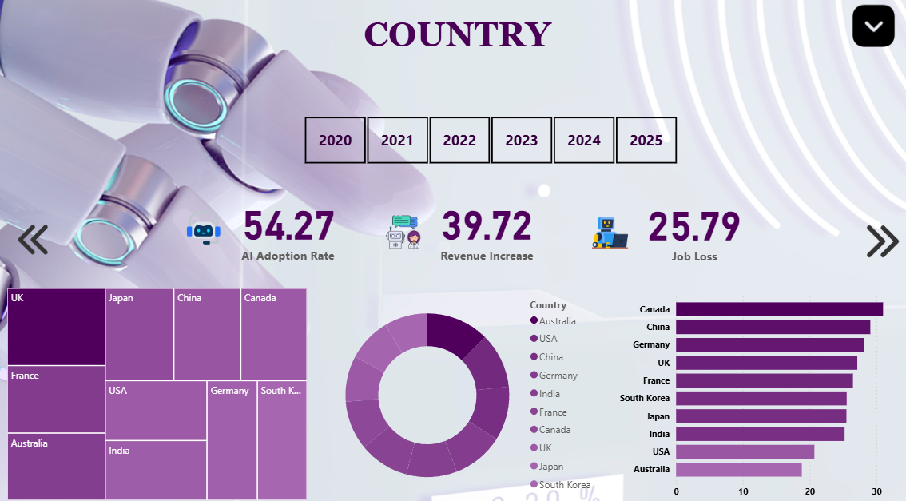

Slide 24
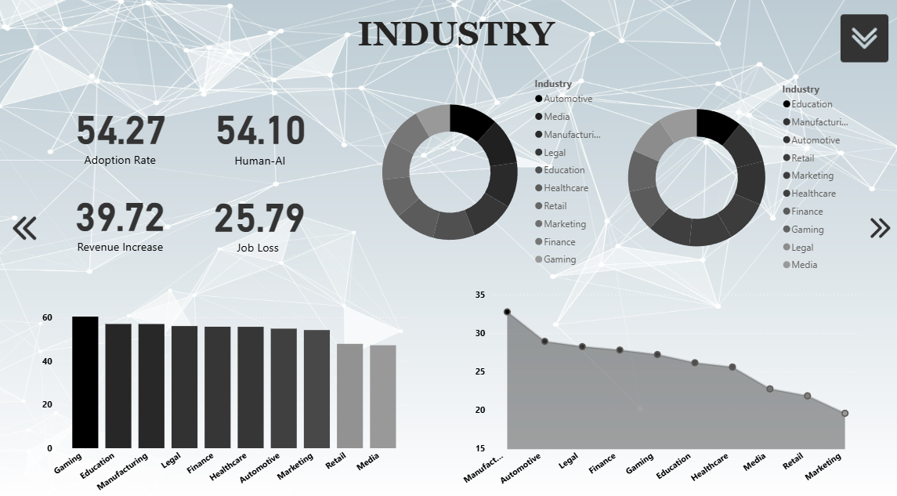

Slide 25
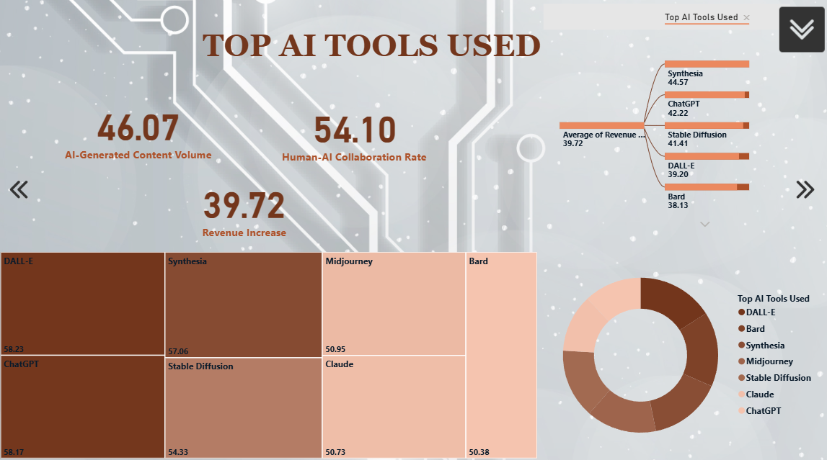

Slide 26
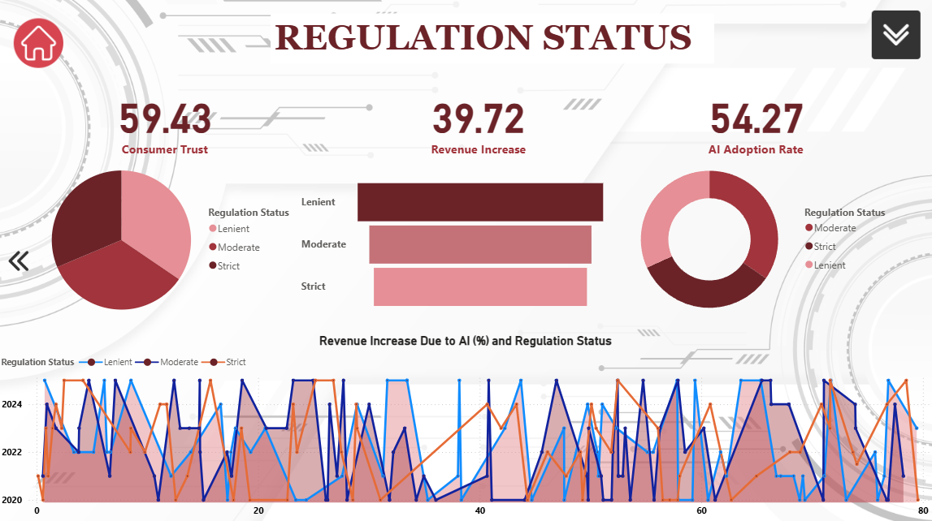

Slide 27
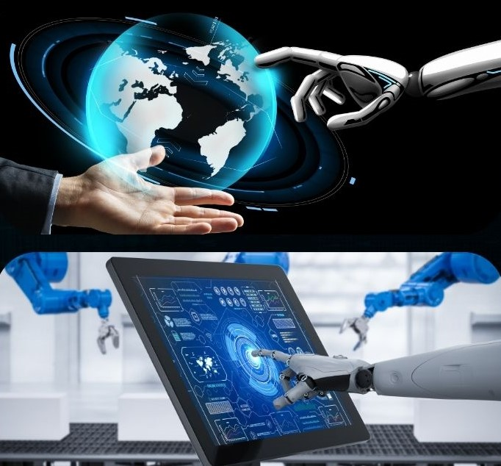
INSIGHTS
Where AI is Growing the Most Countries like the U.S., Canada, and parts of Europe are leading in using AI for creating content. Media, advertising, and tech industries are using AI the most.
2. Revenue is Going Up Where AI is Used Well
Retail and online platforms are seeing big increases in revenue.
AI is helping by making personalized content, like product suggestions or catchy headlines behind paywalls.
3. Work is Becoming Faster and Smarter
AI helps by creating first drafts and visuals quickly—this cuts content creation time by about 33%.
Some Jobs Are at Risk
Jobs that are routine, like basic editing and translation, are most at risk of being replaced by AI.

Slide 28

CONCLUSION
AI-generated content is changing the way businesses operate all over the world. From our analysis, it's clear that companies using AI in smart ways are seeing real benefits:
Faster Growth in Key Regions
More Revenue Through Personalization
Improved Team Efficiency
Some Job Roles Are Changing
Smarter AI Tools Deliver Better Results
In summary, AI-generated content is not just a trend—it’s becoming a powerful tool for business success. When used correctly, it can help companies grow, innovate, and stay ahead in a fast-changing world.

Slide 29
Recommendations & future outlook
🧭 Strategic Recommendations
🔮 Future Outlook
Train People to Work with AI Teach employees how to use AI so they can work better with technology, not be replaced by it.
Use the Right AI Tools Pick AI tools that fit your business needs—don’t just use what’s popular.
Make Fair Rules for AI Create company policies that keep AI use safe and fair for everyone.
Ask Customers What They Think Listen to customers’ opinions about AI to improve trust and service.
AI Will Become More Common More businesses and industries will start using AI to grow faster.
Jobs Will Change People will do more creative and smart tasks while AI handles the boring work.
Not All Countries Will Benefit the Same Countries that prepare for AI now will grow more than others.

Slide 30

❓ Questions & Answers
“Thank you for your attention! Now it’s your turn — I’d love to hear your thoughts or questions.”
🎤 Suggested Prompts to Spark Interaction:
Do you think AI will help or harm jobs in your industry?
What challenges do you see in adopting AI tools?
How can businesses build more trust with customers when using AI?
📌 Feel free to ask about the data, tools, or insights shared today!

